Slide 1
v.2.7 15.11.2013
The Austrian
CHAMBER of LABOUR
Social Academy – Training programme for workers´ representatives
Brigitte Daumen
Notes:
Hello evryone! My Name is Brigitte Daumen, I work at the Austrian Chamber of Labour in Vienna. There I am head of the Social Academy. I would like to present you this training programme and will explaine what we do there.

Slide 2
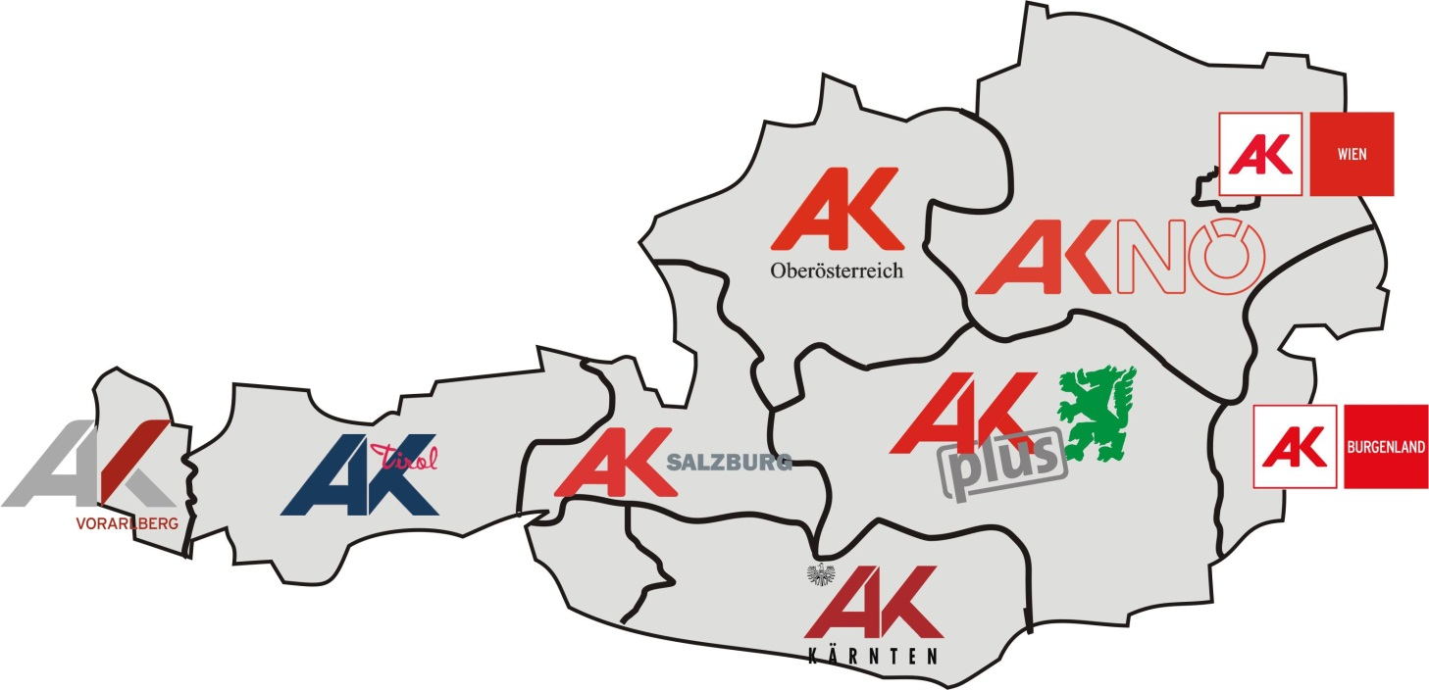
The Chamber of Labour (AK)
represents the interests of more than three million workers and employees in Austria in close cooperation with the trade unions (ÖGB).
Notes:
First I plan to say a few words about the institution Chamber of Labour and than I´m going to talk about the Social Academy.
The Chamber of Labour represents the interests of all austrian workers and employees. We do that in close cooperation with the trade unions. As you see on this sheet we have in all austrian regions a chamber of labour, the headquaters is in Vienna. The membership is compulsary.

Slide 3
Major areas of work
Expertise in economics, social policy, labour law, education and consumer protection
Advisory service and legal protection for members
Training of works councils and union officials
Notes:
The AK´s main task is to give legal advis in labour law to their members, if they have difficulties with their empolyer.
The Chamber is also alowed to give statements/comments on all draft bills, which are proposed by the austrian goverment. Another main task are the trainings of shop stewards. I work in this department.

Slide 4
History
Founded 1920 by law after pressure from trade unions. The aim was to protect and extend social achievements.
Liquidated in 1938 by the Nazis
Re-established in 1945
Notes:
A little bit about the Chambers history: The Chamber of Labour was foundet in 1920, it was the union´s intention to build this organisation, equal to the Chamber of Commerce.

Slide 5
Legal mandate
The Chamber of Labour‘s basic tasks are:
to represent and promote the social, economic, professional and cultural interests of workers and employees
(Article 1 Law on Chambers of Labour)
to support trade unions and works councils and to work jointly with them
(Article 6 Law on Chambers of Labour)
Notes:
The Chamber of Labour has a legal mandate and as you see on this sheet the main tasks are to represent and promote the…….and to support the trade unions.

Slide 6
Organisation
Membership by law
Bodies: general assembly, board, president
Elections every 5 years – turnout roughly 40%
Notes:
As I said before the membership is compusary. Workers and employees vote evry 5 years the general assembly and the president. The last elections have taken place two weeks ago.

Slide 7
Funding
Contribution by members regulated by law
(0.5% of gross salary; max. € 20.10)
Notes:
Perhaps you are interestet how the funding works: Every member pays 0.5 % of her or his gross salary per month. The Chamber dos´nt recive any money from the goverment.
If you have no questions about the structure of the Chamber of Labour I would like to move on to the next part, which is the presentation of the Social Academy.

Slide 8
The Social Academy
A training programme for workers´ representatives
Ten month training programme, fulltime teaching, Monday to Friday
Including a one-month work placement in a foreign country
Notes:
The Social Academy is a special training programme für shop stewards and worker representatives. The duration is ten month from September to June. It´s a fullteime course, that means the classes are from Monday to Friday.
The Social Academy includs also a one month work placemant in a foreign country.

Slide 9
About the Training – Key Points
Legal, economic and sociopolitical know-how
Politics and organisation of the workers´representatives
Key responsibilities like communication training, rhetoric, consulting, negotiation training
Notes:
The main subjects are labour law,economice, political affairs and negotiation training, rhetoric and communication training.

Slide 10
Target group
Members of works councils
Employees´ representatives
Works council secretaries
Employees of the trade unions and the Chamber of Labour
Notes:
As I said before the training is an academy for shop stewards from big companies and also employees from the trade unions and the Chamber of Labour. That means you have to be a shop steward to apply at the academy.
Do you have any questions so far?

Slide 11
Work placement abroad
One month work placement in a foreign country in other trade unions
Supported by the corresponding union
Notes:
Now I would like to speek about the work placement abroad. The studends do a one month placement at other trade unions in whole Europe. This placement is supported by the student´s correponding union.

Slide 12
Work placement - Educational objectives
Setting up information and cooperation networks
Learning about political, economic and social conditions in foreign countries
Getting to know the structures of employees´ representatives and trade unions
Notes:
The work placement have various objectives: first of all we want to set up information and cooperation networks among shop stewards in Europe. Our students should learn about the different political, economic and social conditions in Europe.

Slide 13
Work placement - Educational objectives
Getting acquainted with foreign working and living conditions
Experiencing new cultures and ways of life
Enhancing a solidary way of acting
Notes:
If shop stewards and trade unionists have a good network in Europe, they could work together more easierly in this global world.

Slide 14
What do we ask the host organisations to do?
Offer a workplace and a contact person for the trainee
Help to extend our network
Support for completion of the work assignments
No financial obligations!!
Notes:
The host organisations have no financial obligations. The Chamber of Labour pays the work placement for the students. We ask for a contact person, we ask for somebody who helps to fullfill the work programme, the student have and who helps to extend the network.

Slide 15
Work placement 2014
12th of May – 6th of June
6 different countries
Notes:
This year the work placements take place from 12th of May to 6th of June. We have found trade unions in 6 different countries which help us to realise the placements.
So far my comments to our training programme. Do you have any questions or comments?
Thank you very much for your attention!

